Slide 1
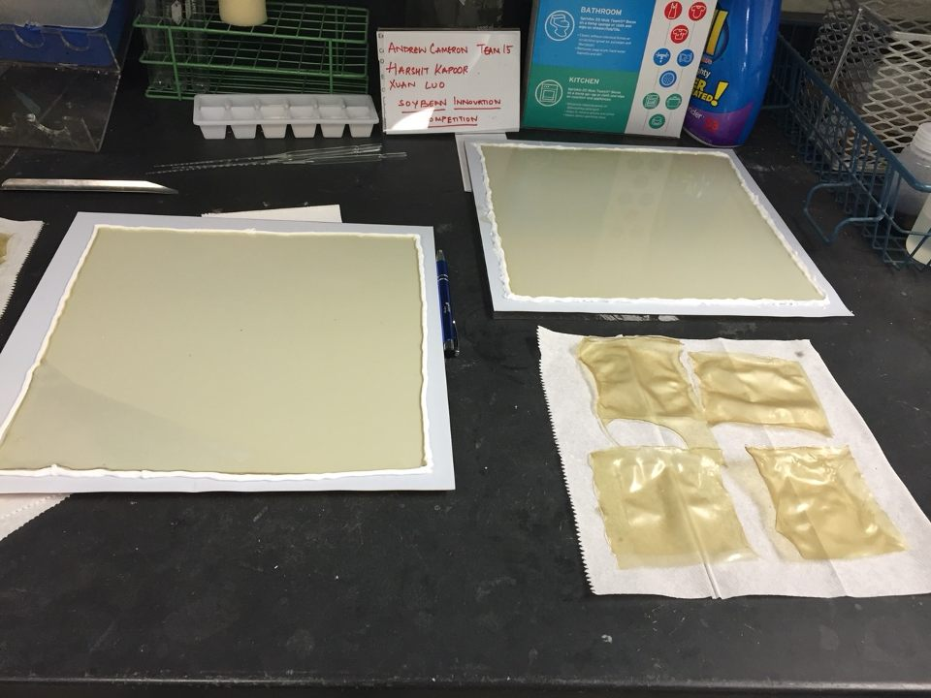
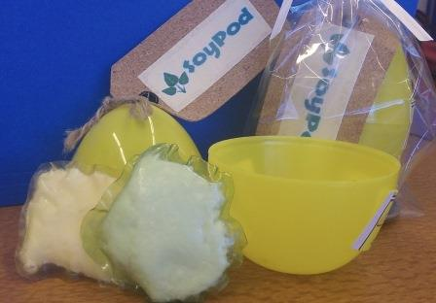
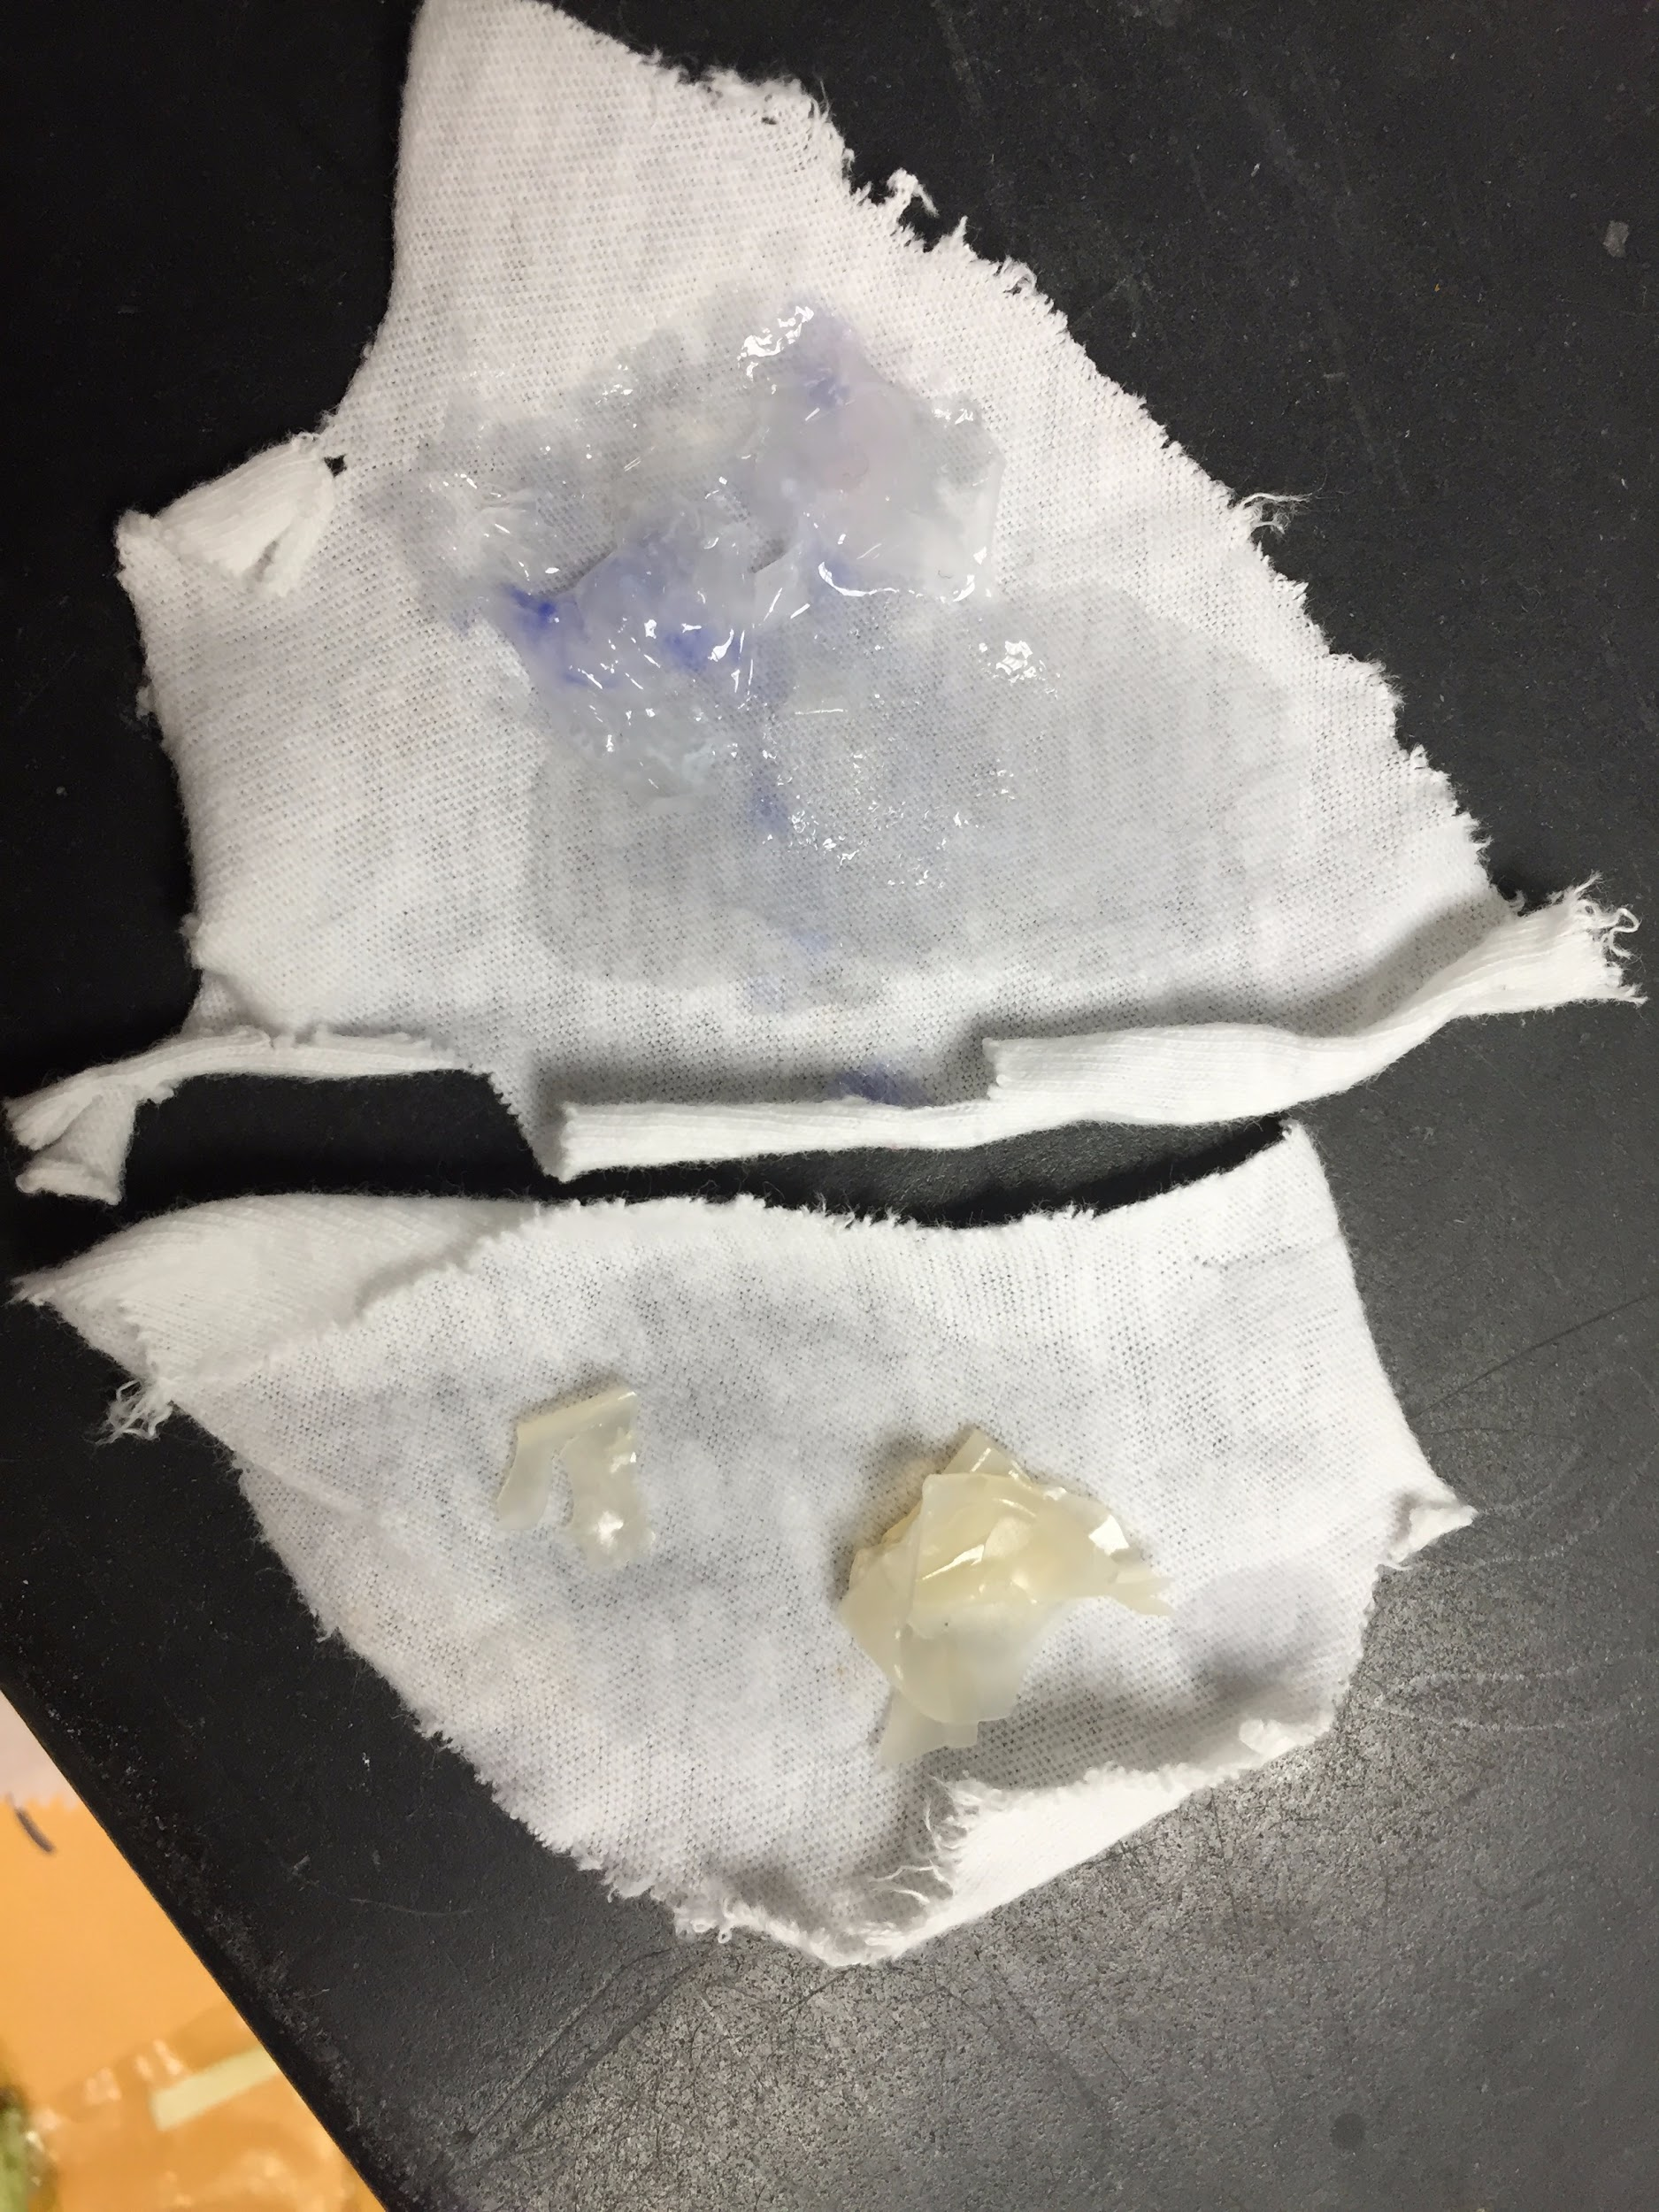
SoyPods
Providing the market with an alternative to PVA films, by using SPI films, specifically for the laundry detergent industry.

