Slide 1
$7.92 Cents-a-Yard Reasons to rethink the “double stick method” of carpet installation

Slide 2
Double-Stick Cushion
Why?
Added Comfort
Improved Performance
Removable
Sound Absorption
Ideal for rolling traffic
Moisture barrier?
Proven track record

Slide 3
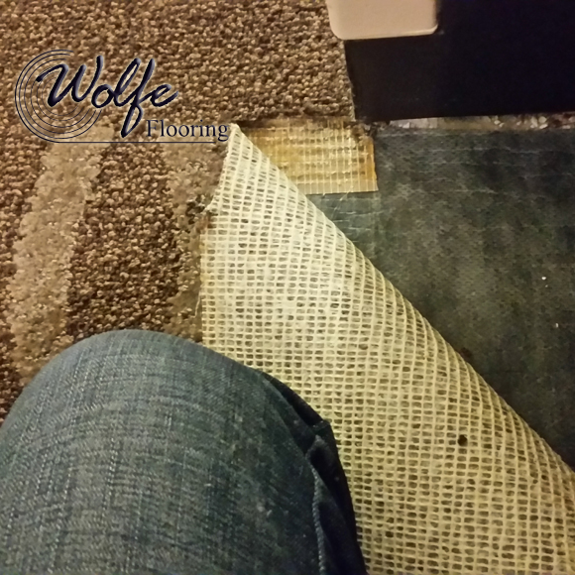
No Adhesive

Slide 4
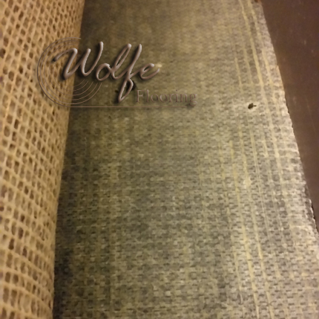
Little Adhesive

Slide 5
CONCLUSION
“The Double Stick Installation Method has been very popular in the past few years and it is continuing to be installed in numerous facilities. However, some manufactures have discontinued or limited their warranties when this method is used.”

Slide 6
CONCLUSION
“Hot water extraction with high alkalinity has been the cause of similar bubbles and loose carpet. In this case Dry Absorption Method is know for its low moisture, and is recommended.”
- Wolfe Flooring Inspection

Slide 8
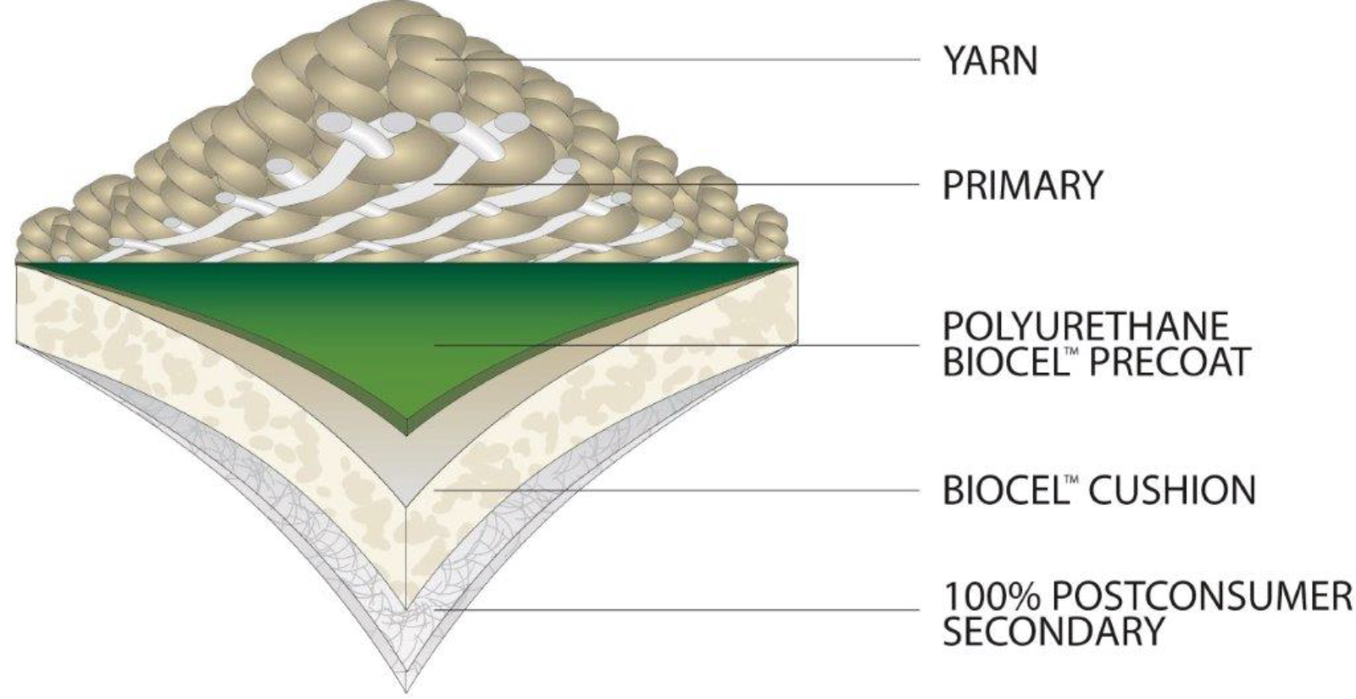
CUSHION

Slide 9
Moisture Resistant
Moisture Barrier
Improved Tuft Bind and Edge Ravel Properties
Great Lamination Strength
Low VOC
Reduces Muscle Fatigue
Sound Insulating Properties
Increased Appearance Retention
Thermal Insulating
Fully Recyclable
Biobased (USDA BioPreferred)
Recycled PET Secondary Backing
Direct Glue Installation
PRODUCT
ATTRIBUTES

Slide 10
1815 sq. yds. ColorPoint w/ Double Stick Installation
Material Cost: $26.49
Cushion: $7.65
Pad Installation: $4.77
Carpet Installation: $5.00
Total: $43.91 sq. yd.
1815 sq. yds. ColorPoint w/ BioCel Cushion
Material Cost: $30.99
Carpet Installation: $5.00
Total: $35.99 sq. yd.
MAXIMIZE
BUDGETS
Total Savings: $7.92 sq. yd. x 1815 sq. yds. = $14,374.80

